Slide 1

Project Nada:
Exploring treatment effectiveness in
a holistic psychology practice
Geoff Lyons, PhD
Clinical Psychologist

Slide 2

THE PROJECT
“
”
Wellness through integration.
Inspirit Psychology uses a combination of evidence-based mental health services with complementary therapies including yoga, hypnosis and energy medicines. Registered health practitioners are mandated to provide evidence-based treatments. The explicit holistic approach of the business is controversial because not all its interventions are currently validated by empirical research. This makes research on the effectiveness of its interventions an essential business need.

Slide 3

Project Nada: Scope
Project Aim
To build a data-driven and ethical integrative psychology practice that can champion holistic mental health in the wellness sector
Today’s business questions
Are our interventions working?
What data will help identify clients’ response to treatment?

Slide 4





DATA QUESTIONS
Knowing our clients
Evaluating effectiveness
Exploring innovation
Identifying fast responders
What is the profile of clients from Aug 2019 to Sept 2020?
Are services significantly influencing wellness over time in treatment?
Are experimental healing treatments producing effects on wellness?
What client features predict response to treatment?

Slide 5








Data approach
Prepare the data Locate, obtain and clean the data.
Model the data Apply machine learning algorithms to the data to reveal preliminary features
Draw conclusions Find the answers needed and plan for implementation or future explorations
Business & data questions What we want to know for the business and what can be asked with the available data
Exploratory Data Analysis Explore the data for features and revelations
Validate the model Validate the models and their preliminary findings.
May apply further feature engineering to refine the models.

Slide 6


THE DATA
DATA SOURCES
CRM
DASS21 OUTCOMES
ENERGY MEDICINE OUTCOMES
CLINICAL NOTES
ID
Name
Type
Source
Age
Suburb
Appointment dates
Name
Appointment dates
Depression subscale
Anxiety subscale
Stress subscale
Name
Appointment dates
Pre/post relaxation score
Pre/post stress score
Name
Diagnosis
Therapeutic r/ship score
Progression score
Demographics, Clinical details
& Progress ratings (n = 237)
Longitudinal DASS21
Data (n = 237)
Energy medicine
pre- post data (n = 42)

Slide 7

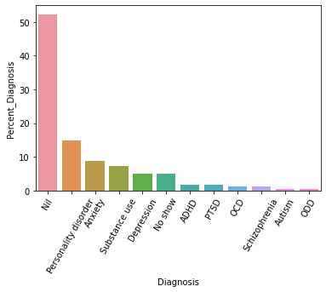


Demographics and clinical features
Source | n (%)
Internet | 123 (52%)
Agency | 50 (21%)
Word of mouth | 38 (16%)
Referral | 26 (11%)
Range of treatment days
1 to 396 days
Mean treatment days
78 days
Range for 50% of clients
8 to 94 days
Client Type | n (%)
Standard | 123 (52%)
Complementary | 97 (41%)
No show | 15 (6%)
Median treatment days
38 days
No. sessions per month
2 sessions
F = 52% M = 48%
Ave = 38 years

Slide 8

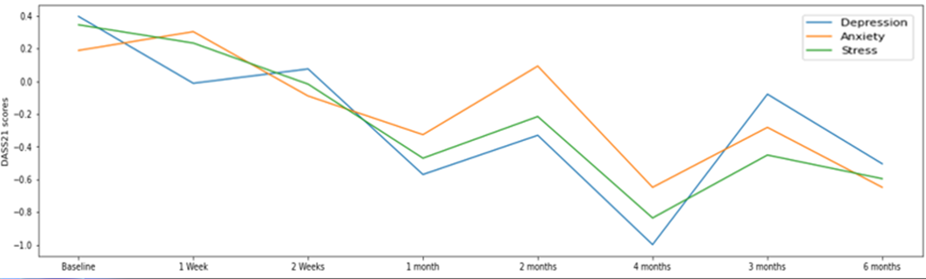
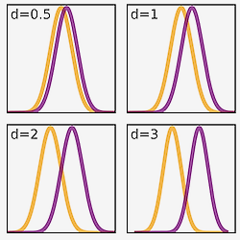
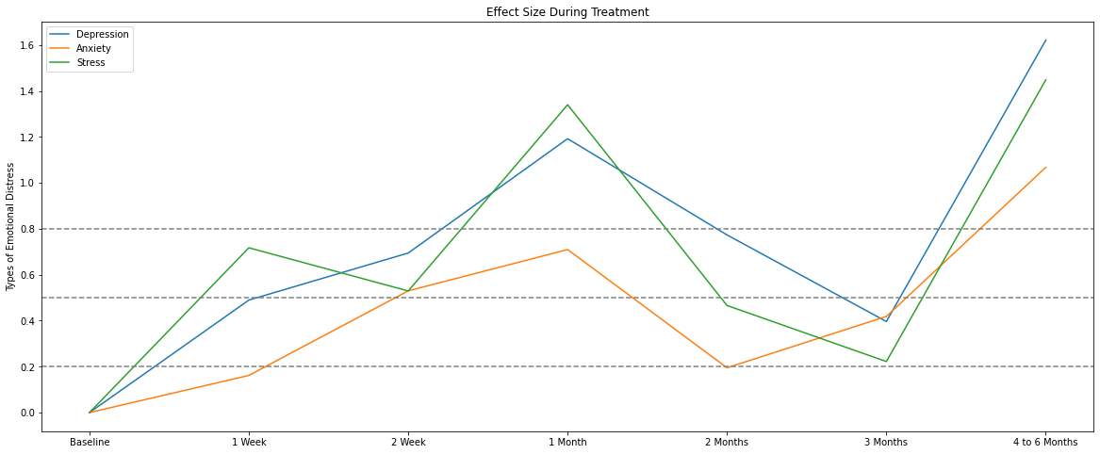
Treatment effectiveness over time
Effect size (d) | Strength
.2 | Small effect
.5 | Medium effect
.8 | Strong effect

Slide 9
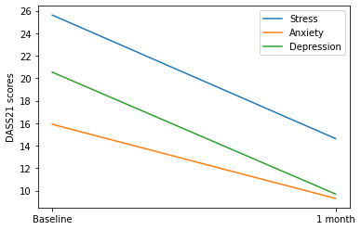
One month treatment effectiveness
Significant reductions in Stress, Anxiety and Depression are seen within the first month of treatment
 | Baseline M(SD) | 1 month M(SD) | p | d
Stress | 25.61(8.84) | 14.63(7.70) | <.001 | -1.33
Anxiety | 15.90(10.85) | 9.32(7.66) | <.001 | -0.71
Depression | 20.54(10.11) | 9.71(8.17) | <.001 | -1.18

Slide 10


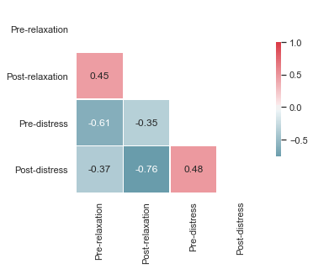
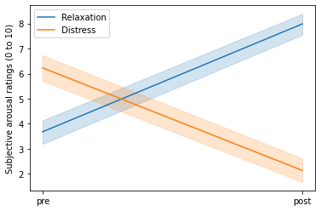
Effectiveness of “energy medicine”
 | Pre M(SD) | Post M(SD) | d
Relaxation | 3.68(1.87) | 7.98(1.65) | 2.44
Distress | 6.23(1.87) | 2.13(1.76) | -2.25
Effect size (d) | Strength
.2 | Small effect
.5 | Medium effect
.8 | Strong effect

Slide 11

Classifying client progress
Question:
Can we predict who will progress well and who will progress poorly with the data we have available?
Considerations:
What “features” of a client’s presentation best predict progress?

Slide 12
Supervised learning models
Model features
Age
Standard or complementary client
Received EM
Referral source
Gender
Therapeutic relationship
Personality disorder
Target variable
Progress
Relevant features
Age
Therapeutic relationship
Personality disorder
Algorithms | Accuracy | Precision | Recall | ROC
Random Forest | 73% vs 74% | 80% | 76% | 76%
Logistic Regression | 73% vs 76% | 83% | 77% | 80%
XGB Regressor | 72% vs 69% | 76% | 73% | 71%
Naive Bayes | 72% vs 76% | 83% | 77% | 78%
KNN | 71% vs 51% | 59% | 61% | 45%

Slide 13

Recommendations
Findings
Good evidence that interventions are effective
Age and therapeutic relationship are the best features for classifying response to treatment
Next steps:
Continue analyses with greater numbers
Focus on capturing data on age and therapeutic relationship
Personality disorders are important but could be recorded better
Report preparation & dashboard development

